Slide 1

How do people like Tesla?
An insight report based on comments from YouTube and Reddit
Project for Web Intelligence
Xu Zhang, Yuxi Qiao
23/03/2022

Slide 2
Table of Contents
Motivation
Data Extraction
Sentiment Analysis
Topic Modeling
Retrieve from Wikipedia

Slide 3
Motivation

Slide 4
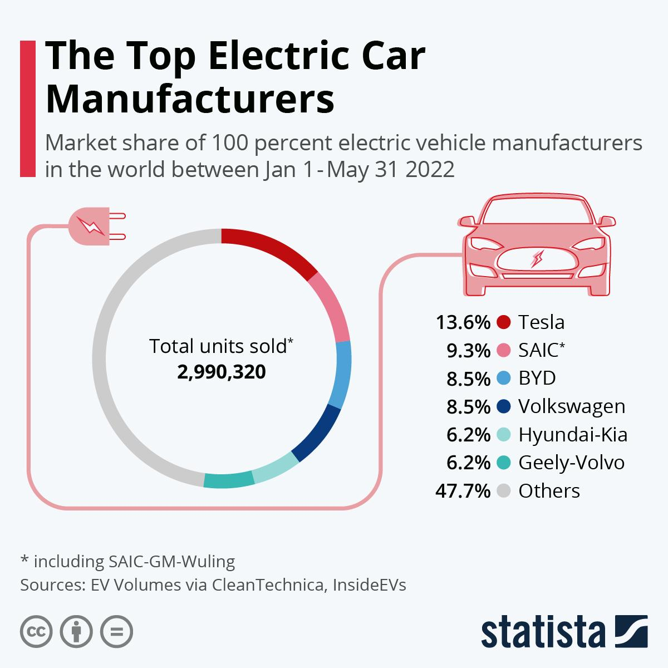
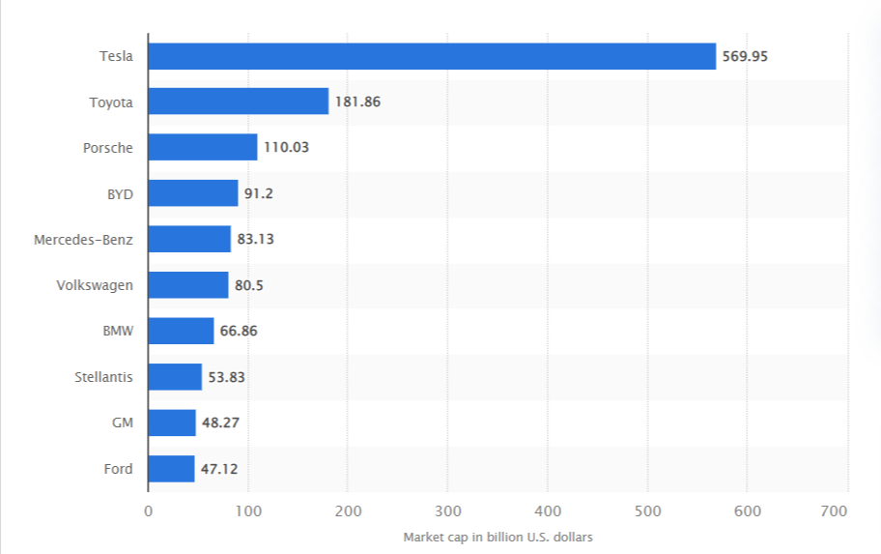
Motivation
Electric vehicles have become increasingly popular. Tesla has become one of the most successful and innovative companies in this field. Moreover, its market capitalization exceeds that of traditional car manufacturers.
So we choose Tesla as our study object to see people how to comment.
Global market value of carmakers as of March 20, 2023 by market cap
https://www.statista.com/chart/27733/battery-electric-vehicles-manufacturers/
https://www.statista.com/statistics/1130533/global-market-value-of-carmakers-by-market-cap/

Slide 5
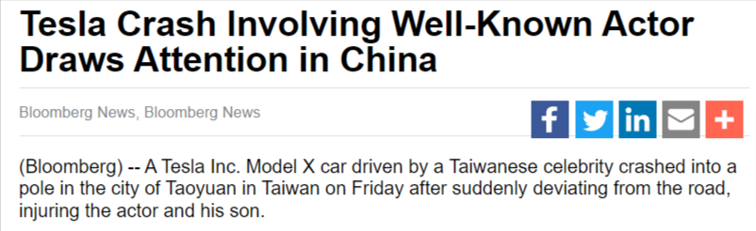
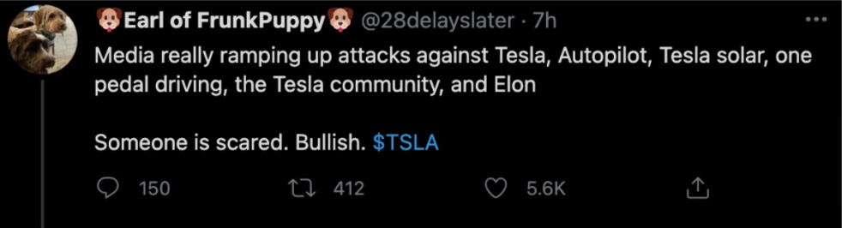
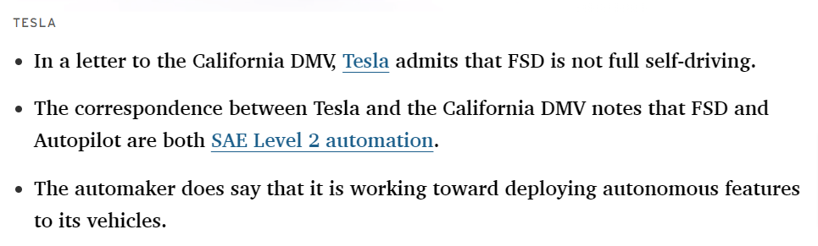
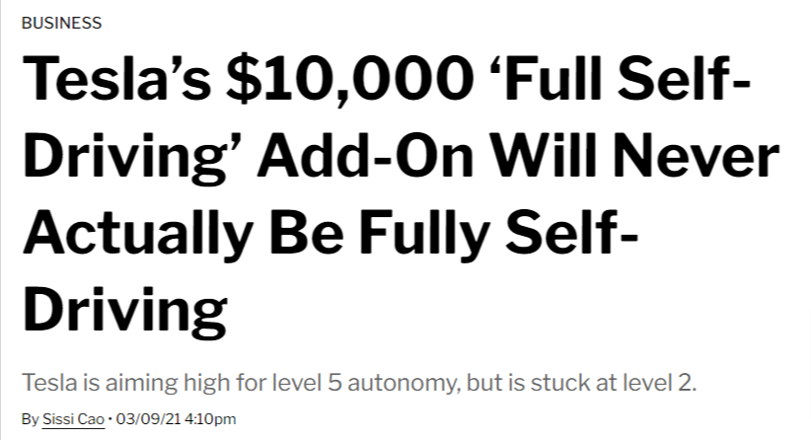
Motivation
People online have been generous with their praise for Tesla. However, there are also many Negative news and comments on it. For example, misleading on “Self-Driving”, safety issues, quality issues, etc.
What exactly do people think of it?
We study the comments on YouTube and Reddit to gain an insight into what people say about it.
https://www.caranddriver.com/news/a35785277/tesla-fsd-california-self-driving/
https://observer.com/2021/03/tesla-full-self-driving-beta-level-2-not-self-driving/
https://electrek.co/2021/04/22/elon-musk-dismisses-valid-criticism-of-tesla-weird-attacks-media/
https://www.bnnbloomberg.ca/tesla-crash-involving-well-known-actor-draws-attention-in-china-1.1795484
https://en.wikipedia.org/wiki/Criticism_of_Tesla,_Inc.

Slide 6
Data Extraction

Slide 7
Data Extraction
Reddit
YouTube

Slide 8
Data Extraction
API
Reddit
Subissions
Keyword: Tesla Model
YouTube
Videos
Selenium

Slide 9
Data Extraction
API
Reddit
Subissions
comments of submissions
Keyword: Tesla Model
Extract comments
YouTube
Videos
comments of videos
Selenium

Slide 10
Data Extraction
API
Reddit
Subissions
comments of submissions
Comment data
Keyword: Tesla Model
Extract comments
Merge & Clean
3562 from Reddit
1705 from YouTube
YouTube
Videos
comments of videos
Selenium

Slide 11
Sentiment Analysis

Slide 12
Sentiment Analysis
In order to obtain a more comprehensive result, we use two ways to analysis the sentiment of comments
Cleaned data
VADER
RoBERTa
Use linguistic rules and emotion dictionaries to determine the emotional polarity (positive, neutral, or negative) and intensity of a text.
A Transformer-based language model pre-trained on a large amount of text data using a masked language modeling objective

Slide 13
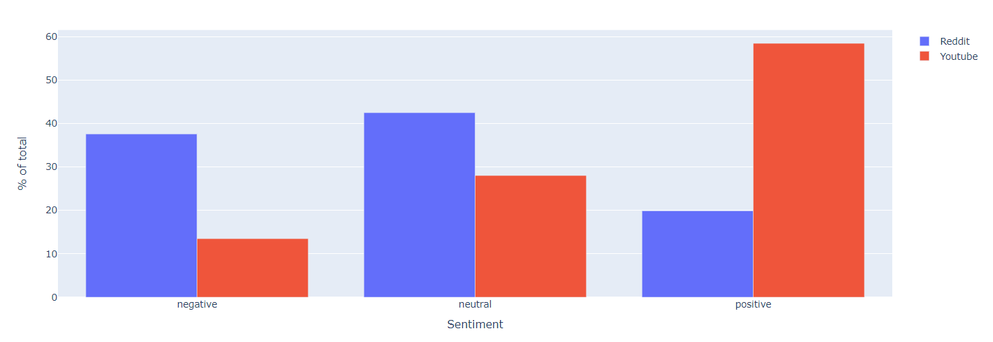
Sentiment Analysis
Sentiment comparison between Reddit and YouTube users

Slide 14
Sentiment Analysis
Reddit users’ overall attitude is not very positive.
More than half YouTubers hold positive comment on Tesla Models.

Slide 15
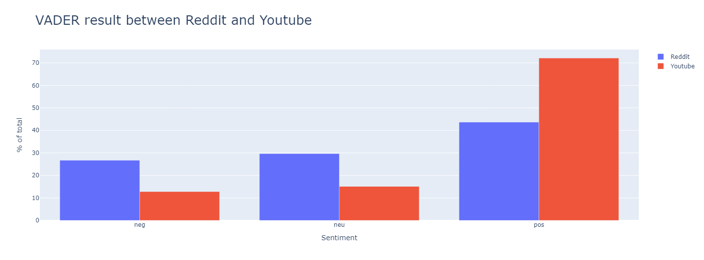
Sentiment Analysis

Slide 16
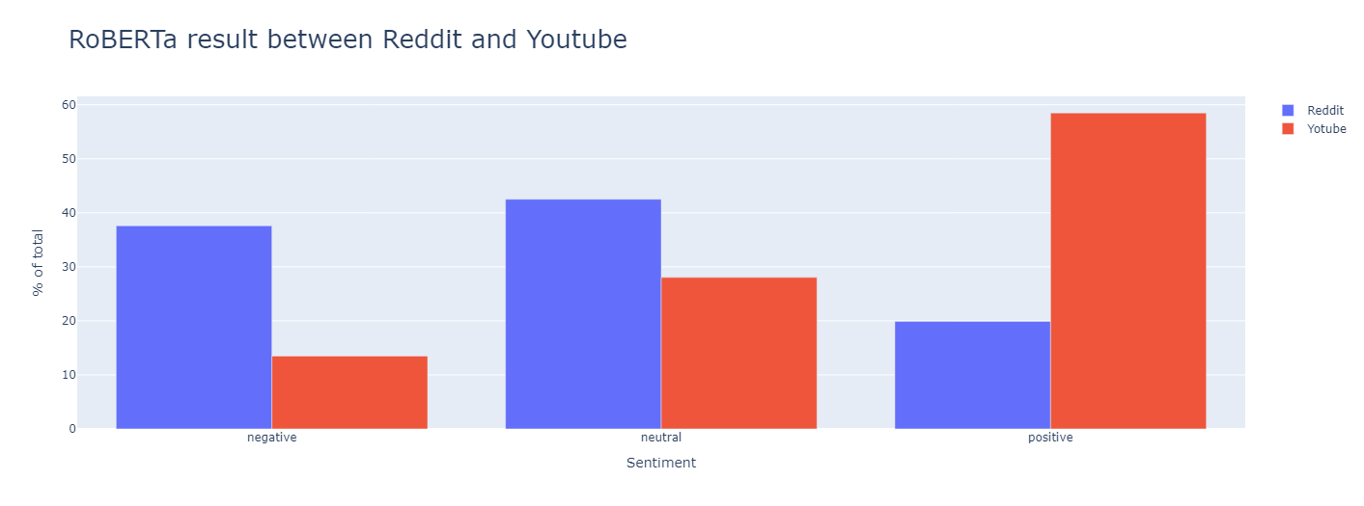
Sentiment Analysis

Slide 17
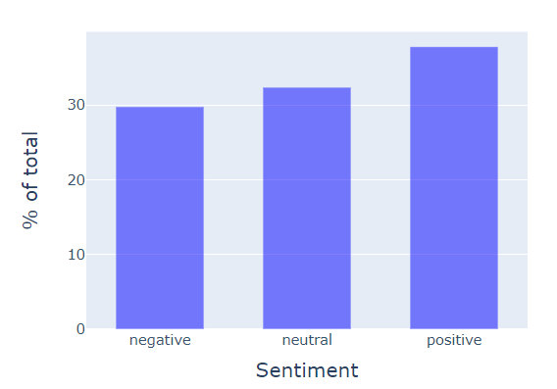
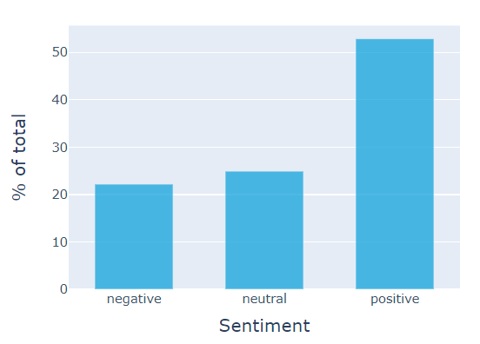
Sentiment Analysis
Analysis results of VADER and RoBERTa
Sentiment analysis by VADER
Sentiment analysis by RoBERTa

Slide 18
Sentiment Analysis
Reddit users’ overall attitude is not very positive.
More than half YouTubers hold positive comment on Tesla Models.
Although sometimes there is negative news about Tesla Model, most of the users have positive or at least neutral comments on this hard-to-beat vehicle.

Slide 19
Topic Modeling

Slide 20
Topic Modeling
What aspects of Tesla are the users concern the most?

Slide 21
Topic Modeling
What aspects of Tesla are the users concern the most?
By modeling a total of more than 5K comments scraped from Reddit and YouTube using the LDA topic model, we set the number of topics to 10 after comparing the consistency values ​​of different topics.

Slide 22
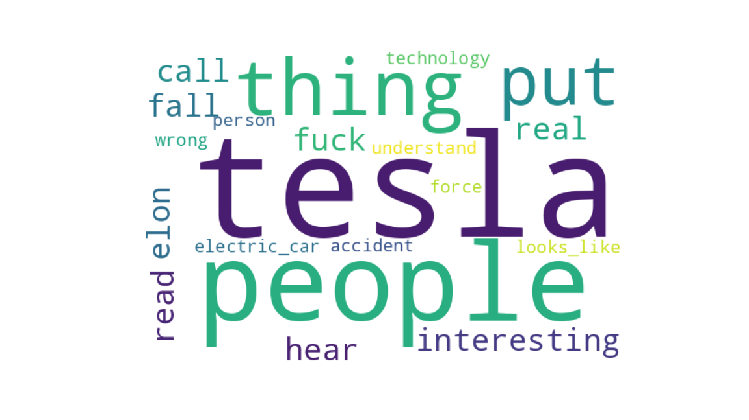
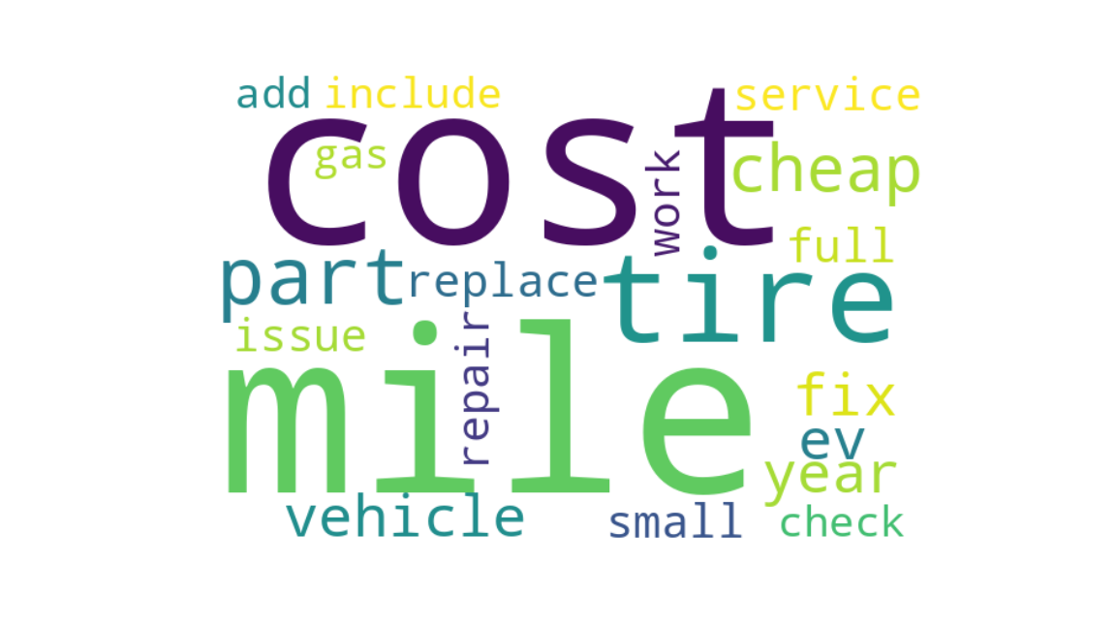
Topic Modeling
Topic 1: Keywords include Tesla, people, interesting, technology, electric vehicles, etc.
This topic may involve Tesla's new technology, new models, and the company's leader Elon Musk.
Topic 2: Keywords include mileage, cost, tires, repairs, etc.
This topic may involve the maintenance costs and repair issues of Tesla vehicles, as well as the replacement of vehicle components.

Slide 23
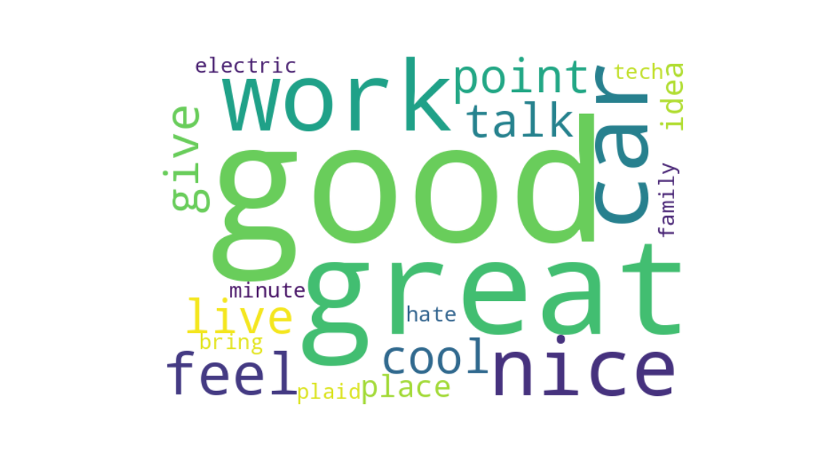
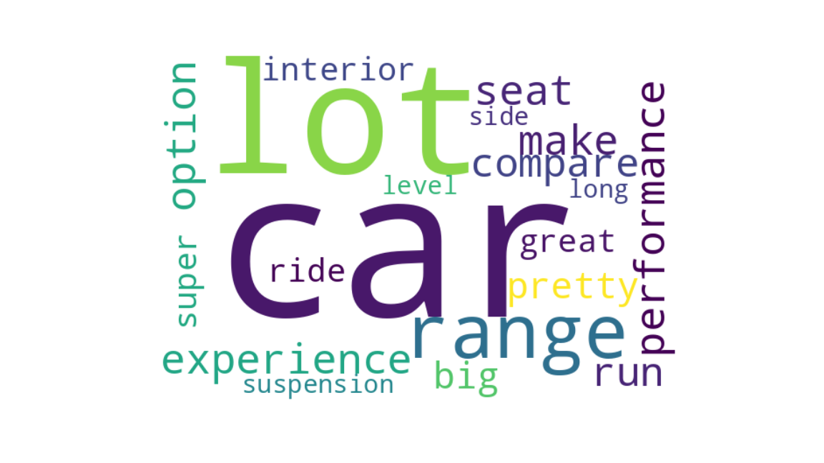
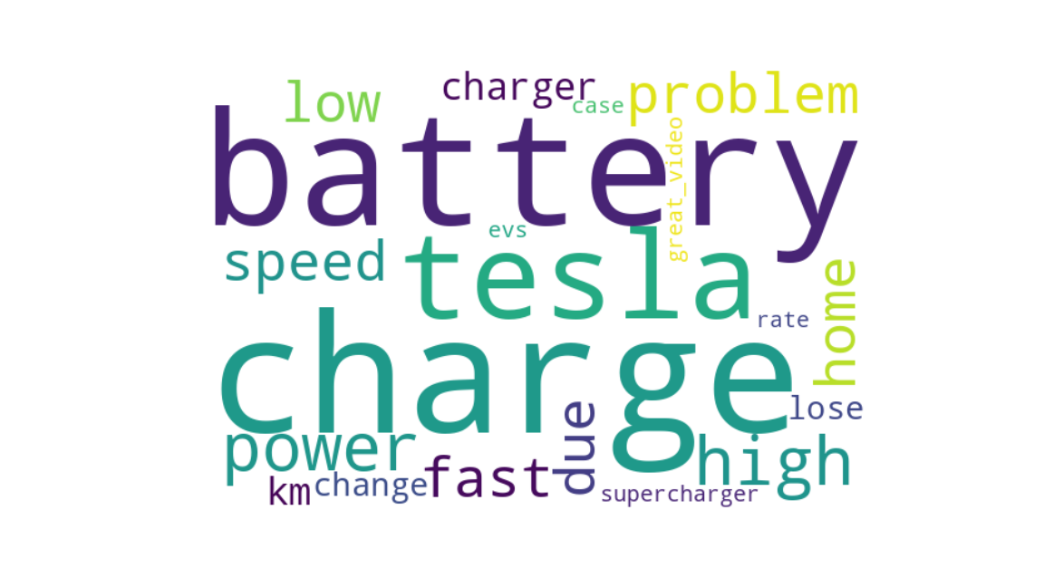
Topic Modeling
Topic 3: good, feeling, electric, technology, discussion, etc.
This topic may discuss people's feelings and opinions on Tesla models, as well as the development trend of electric vehicles and technology.
Topic 4: vehicle, performance, interior, seats, etc.
This topic may involve the performance, interior design, and configuration of Tesla vehicles.
Topic 5: charging, battery, problems, charging stations, etc.
This topic may involve the charging problems of Tesla vehicles, battery life, and the layout of charging stations.

Slide 24
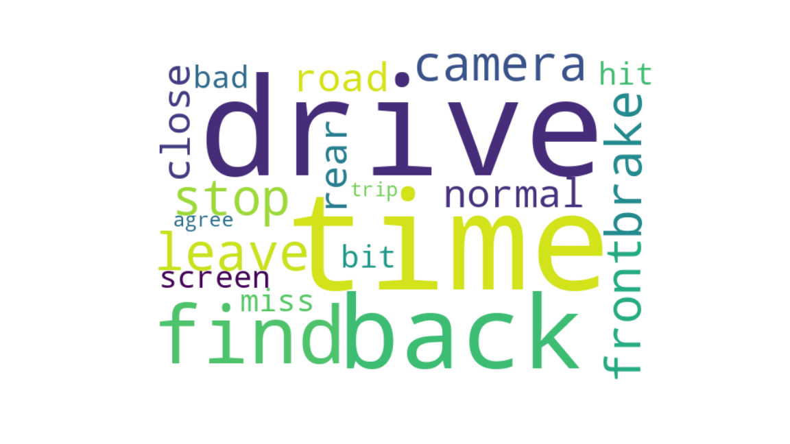
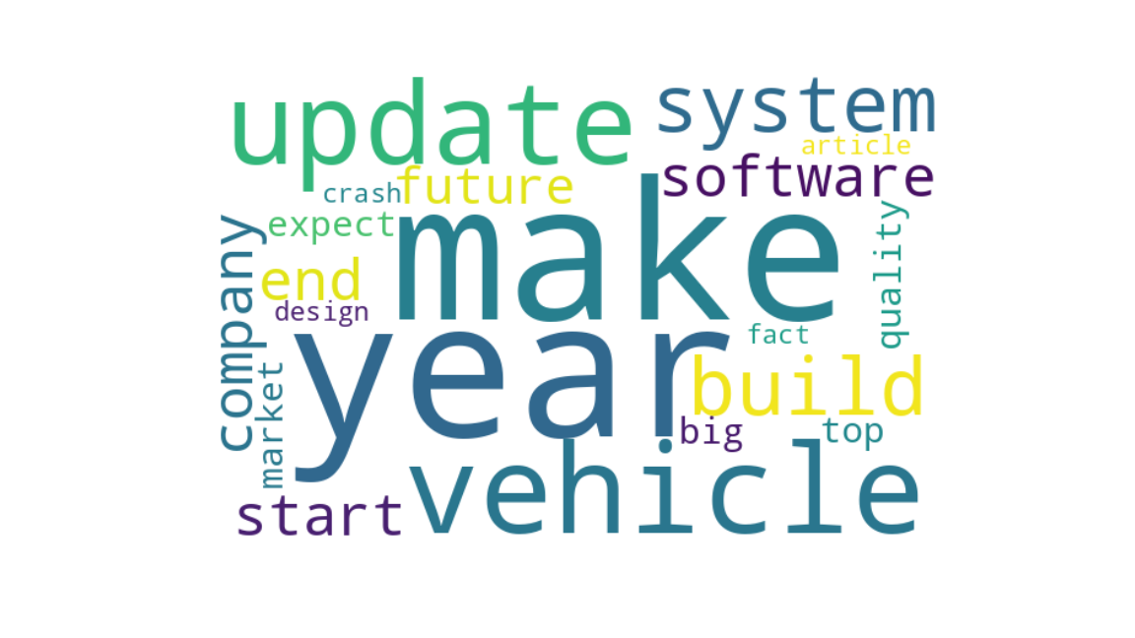
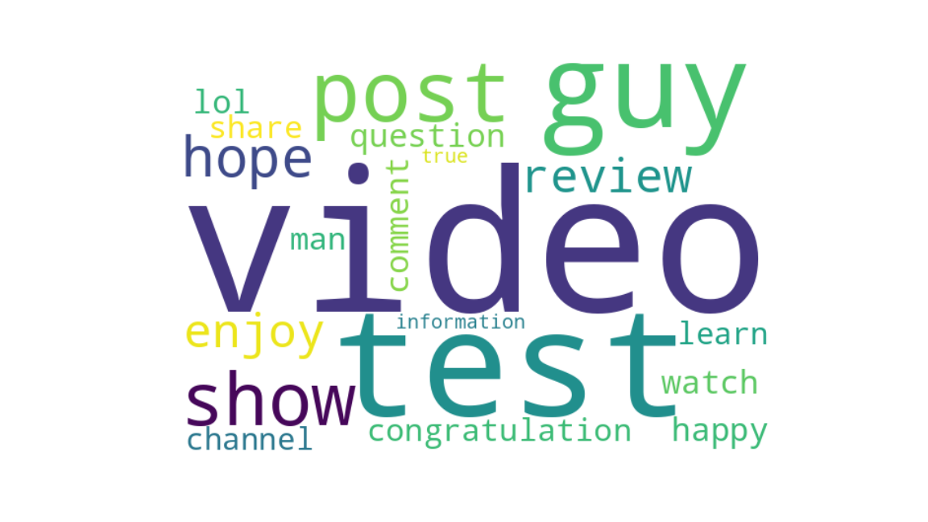
Topic Modeling
Topic 6: Keywords include drive, time, front and back, screen, braking, etc.
This topic may involve driving experience control system, screen interface, and braking system of Tesla vehicles.
Topic 7: Keywords include videos, tests, reviews, information, etc.
This topic may involve the evaluation videos of Tesla vehicles, user experiences, and technical information of the vehicles.
Topic 8: Keywords include make, software, system, quality, design, etc.
This topic may involve Tesla's product manufacturing and software development, future development trends, quality and design.

Slide 25
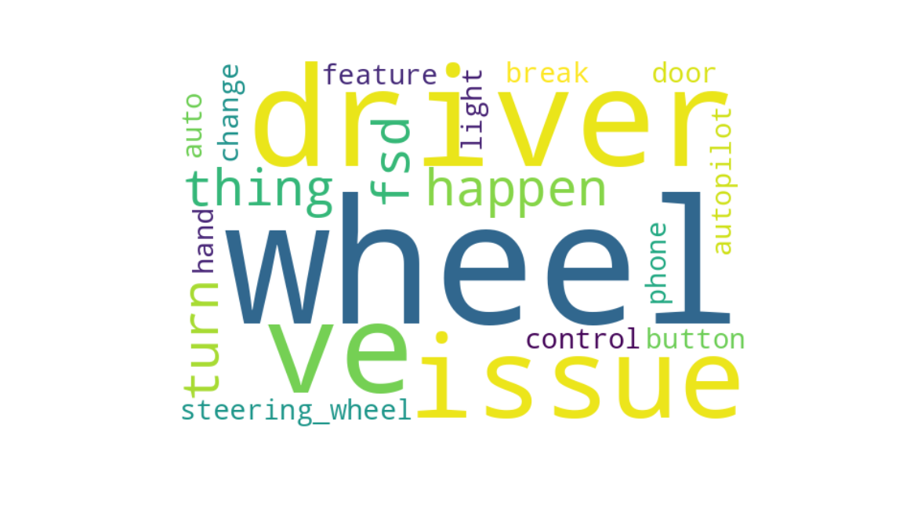
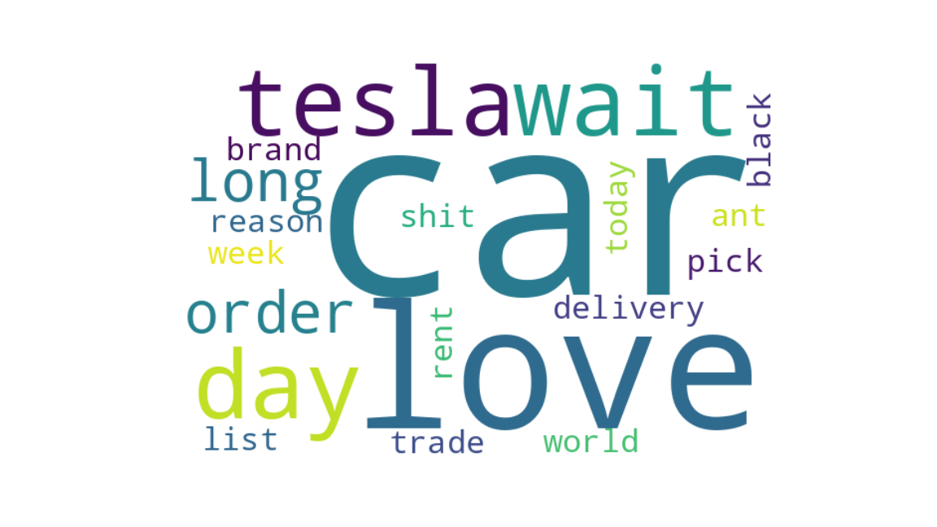
Topic Modeling
Topic 9: Keywords include steering wheel, autopilot, control, buttons, etc.
This topic may involve the autopilot system, control interface, and operation buttons of Tesla vehicles.
Topic 10: Keywords include love, waiting, delivery, leasing, etc.
This topic may involve users' degree of love for Tesla vehicles, waiting for purchase, delivery process, and leasing of vehicles.

Slide 26
Connect to Web Resources

Slide 27
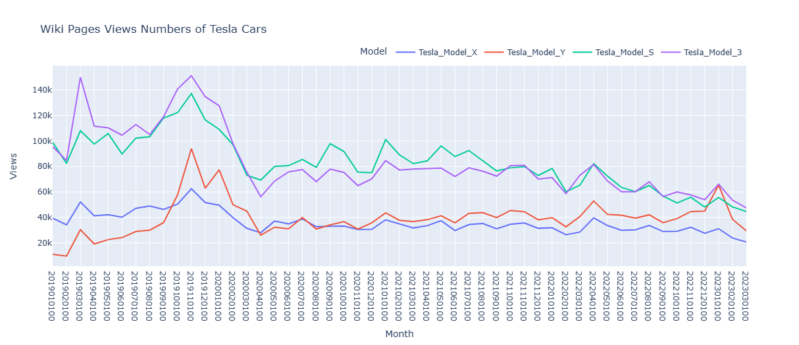
Connect to Web Resources
Pageviews of different Tesla Models in Wikipedia

Slide 28
Application
Our research could help electric vehicle manufacturers better understand the demands and preferences of their users, which can guide the development of new electric vehicles.

